Slide 1
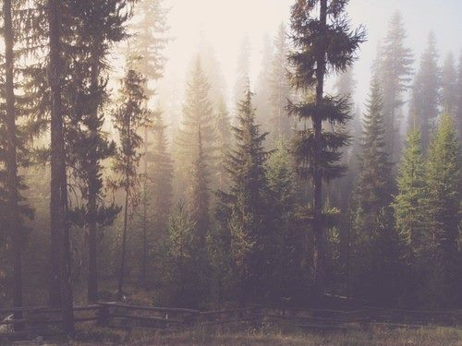
„Forests in Poland and Europe. Characteristics and management” „What is most beautiful in the Bieszczady”

Slide 2
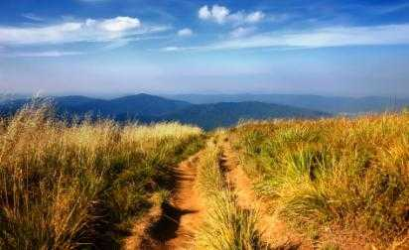
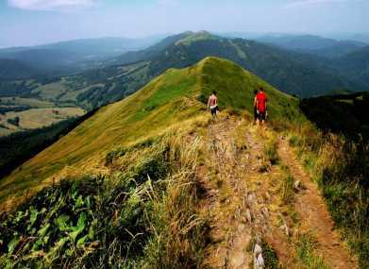
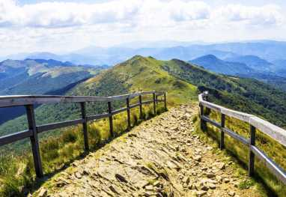
BIESZCZADY
The Bieszczady is not only a place which is worth seeing, but also a state you should experience, and which you’ll miss right after coming back. It’s one of the last this wild and inhibited areas in Poland. It’s a vast land of wilderness where you can admire beautiful and unique views. Only here you can find so many unique plants and animals species.

Slide 3
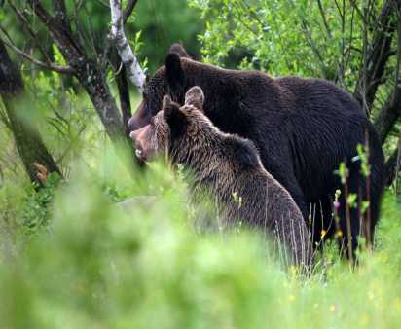
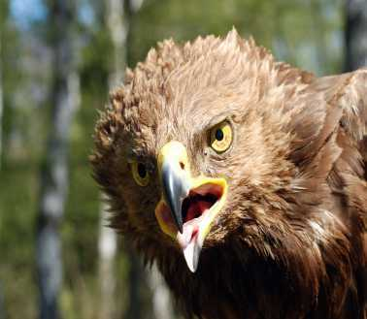
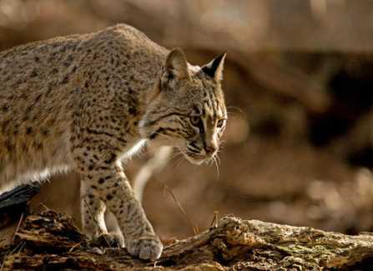
FLORA AND FAUNA
Bieszczady’s flora and fauna is exceptional. In There are 3 plant floors in the Bieszczady . The conditions in the Bieszczady determine the existence of species such as: bears, wolves, deer, lynxes, bisons, wildcats. You could find there 200 species of birds ,most interesting are: Halny owl, Golden eagle and Vulture.

Slide 4
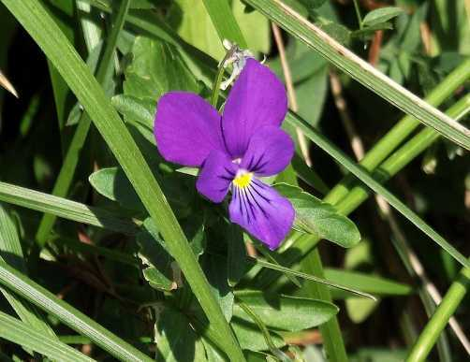
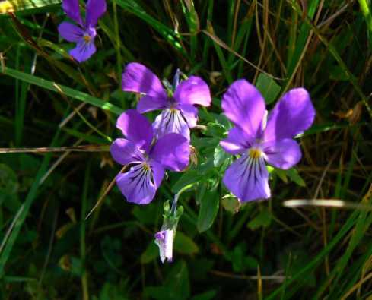
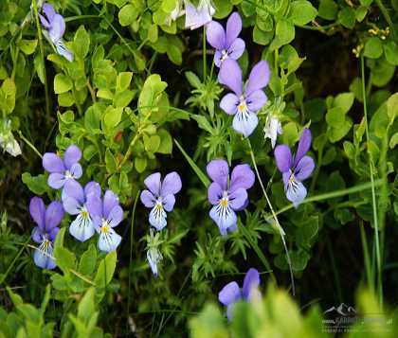
VIOLET DACKI
It is species of plant belonging to the violaceous family . In Poland this plant is rare. It occurs only in the pastures in Bieszczady. It has got petal flowers facing upwards the flowers often are purple but sometimes they are brighter.

Slide 5
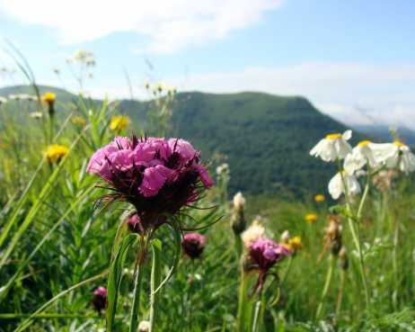
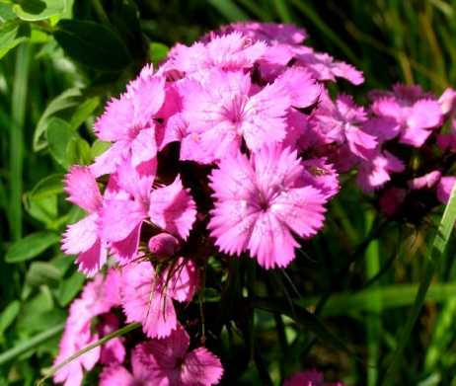
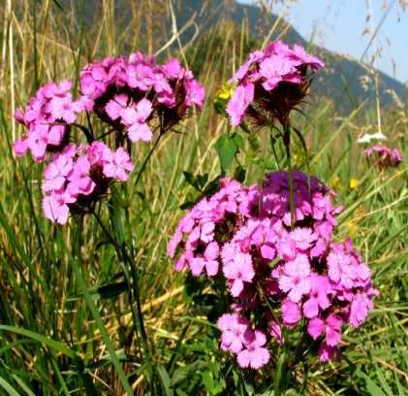
GOŹDZIK SKUPIONY
In Poland occurs only in the Bieszczady. It is protected. It looms in July and August. It’s flowers are pink or red and rarely white.

Slide 6
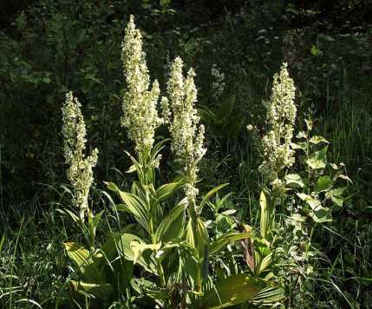
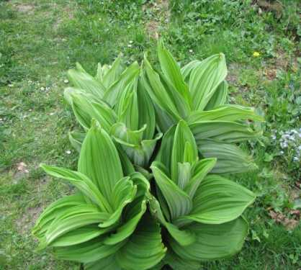
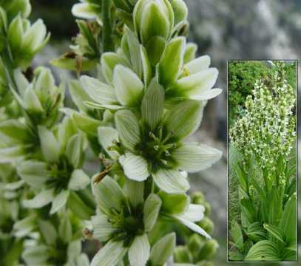
VERATRUM WHITE
Is a plant which occurs commonly in the part of norther hemisphere of the Polish Bieszcady. Veratrum white is a plant of many years. The plant blooms with white flowers. It’s poisonous.

Slide 7
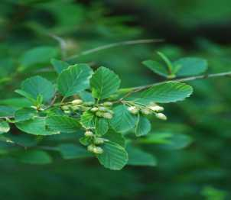
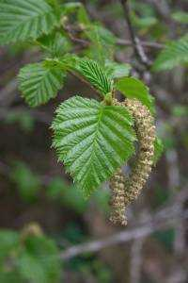
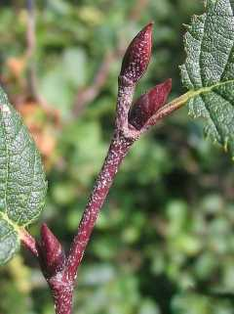
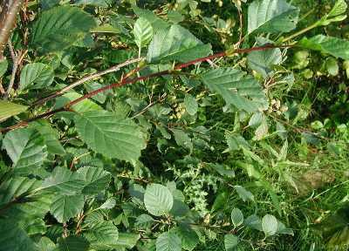
GREEN ANLDER
Is a valuable species that protects the soil from erosion and damages. It used to prevent forming landslides in areas of erosion. It contributes in dehydration and helps in reclaiming soil. It shows that you can find it on every high mountain peak. In Bieszczady it should be used when renewing upper limit border floor of the forest

Slide 8
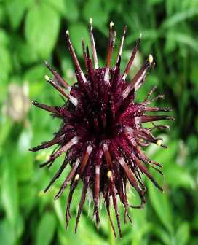
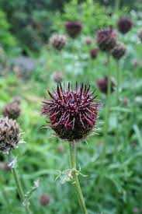
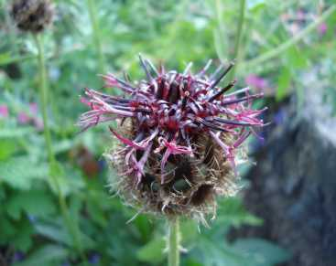
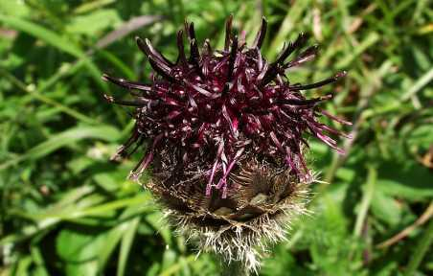
KATSCHY’S CORNFLOWER
In Poland it occurs only in Western Bieszczady. It grows in on the pastures and mid-forest glades. All wild-growing specimens in Poland grow in area the Bieszczadzki National Park, mostly under strict protection. In addition, collected seeds are used to grow a population of this species in scientific didactic station’s garden of Bieszczady National Park in Suche Rzeki.

Slide 9
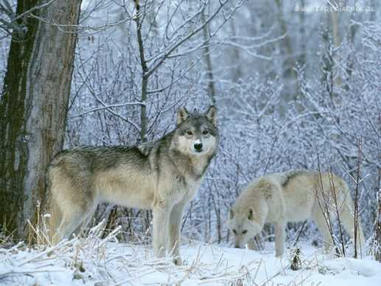
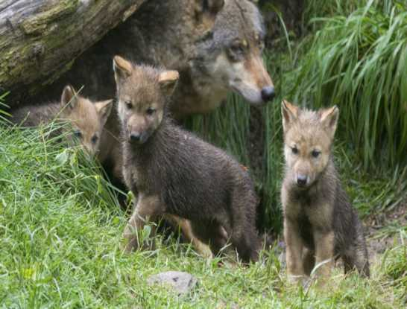
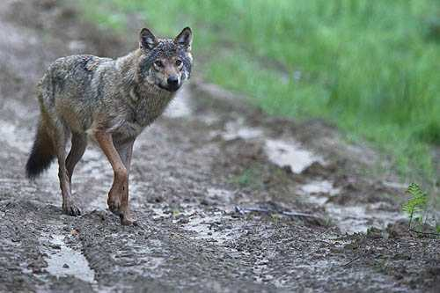
WOLF
Type of mammals of canidae family, they have 24- hour activity to hunt effectively they need at least a little bit of light. Usually they hunt at dawn and at dusk. They are adapted to human’s daily activity, because they rather not get in our way .In the Bieszczady there are 5 of wolves, and only 3 of them were young.

Slide 10
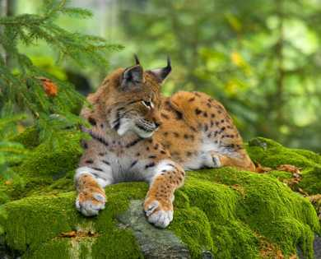
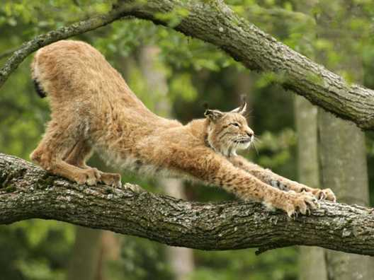
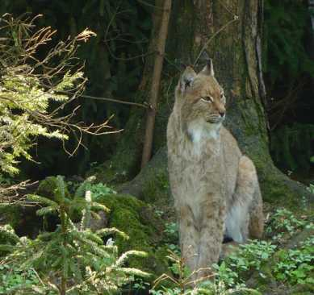
LYNX
The biggest of European felines. Inhibits large forest complexes and leads a secretive life style. It’s a carnivorous species and it’s basic food are wild ungulates, mostly deer. In the Polish Bieszczady lives about 20 lynxes.

Slide 11
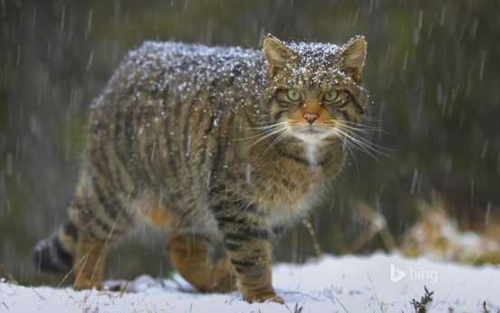
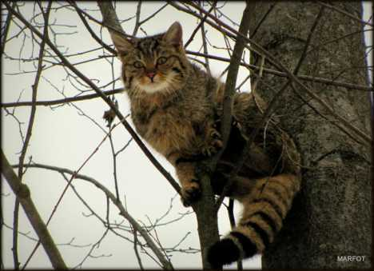
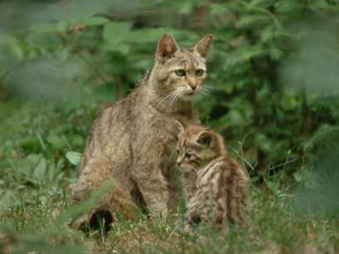
WILDCAT
Is similor to domestic cat, but it’s a little bit bigger. It used to occur in whole Europe. Nowadays in Poland you can only find it in the mountains. It leads a reclusive life style. Wildcat build nests in tree hollows , rock crevices or burrows. It feeds mainly on rodents, birds, fish, insects and lizards. Sometimes it hunts haves. The number of wildcats in the Bieszczady regions is unknown. Meeting this interesting predators are accidental and rare.

Slide 12
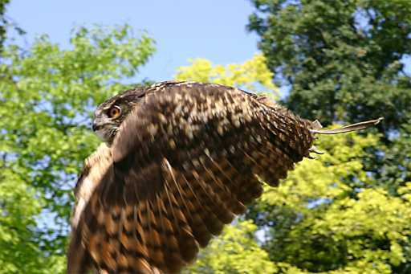
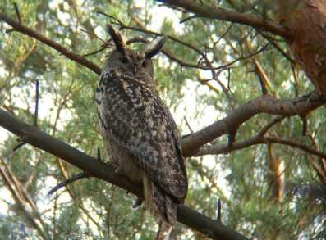
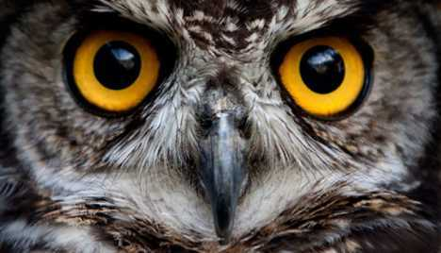
EURASIAN EAGLE-OWL
Is one of the largest owl species in the wolrd with a wingspan nearly two meters. It used to be exterminated because it was associated with evil and death. Nowadays it’s very rave and livid bird, but the population of the species is slowly getting bigger. It can turn it’s head for 270 ° degrees, which rewards it rather limited viewing angle compared to other birds. It can live up to over 20 years in natural environment, in captivity even up to 60 years.

Slide 13
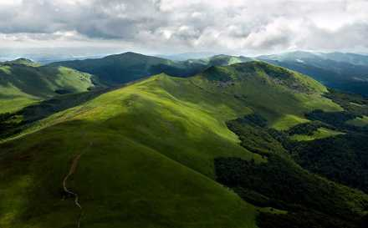
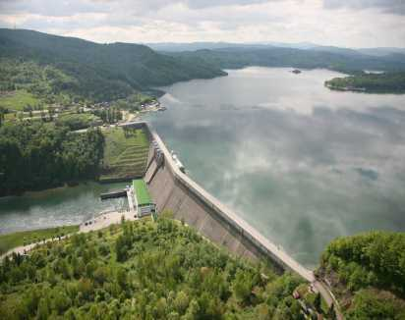
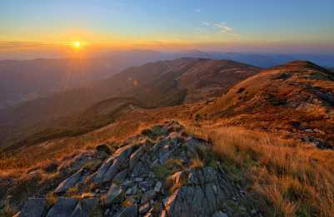
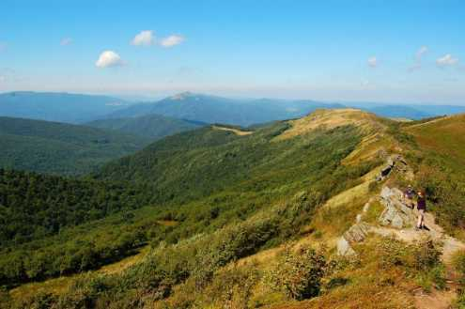
SOURCE
http://zielnik-karpacki.pl
http://ziolowyporadnik.pl
http://www.encyklopedia.lasypolskie.pl
http://www.grupabieszczady.pl
http://www.twojebieszczady.net
http://bieszczady.land

Slide 14
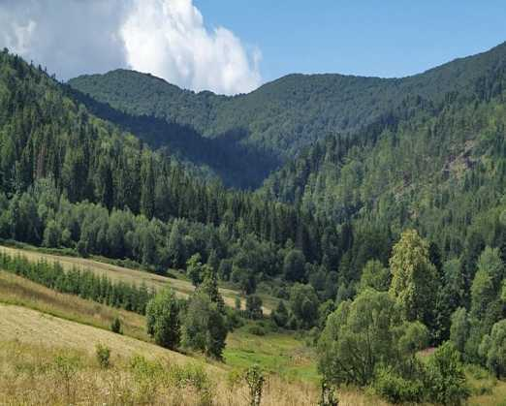
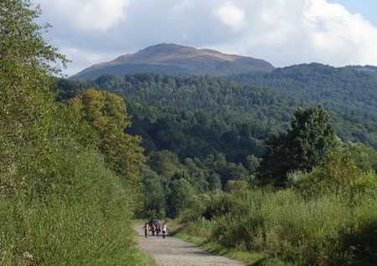
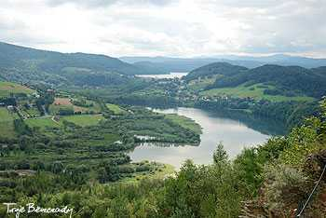
CREATORS
Zespół Szkół Elektronicznych i Ogólnokształcących w Przemyślu
Dominika Cypara 1y
Justyna Halendy 1y
Paulina Mołoń 1y

